Slide 1
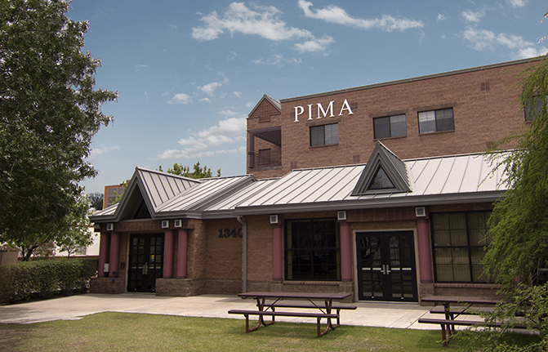
Exploratory Data Analysis (EDA) and Cleaning Pima County Housing Data Set

Slide 2
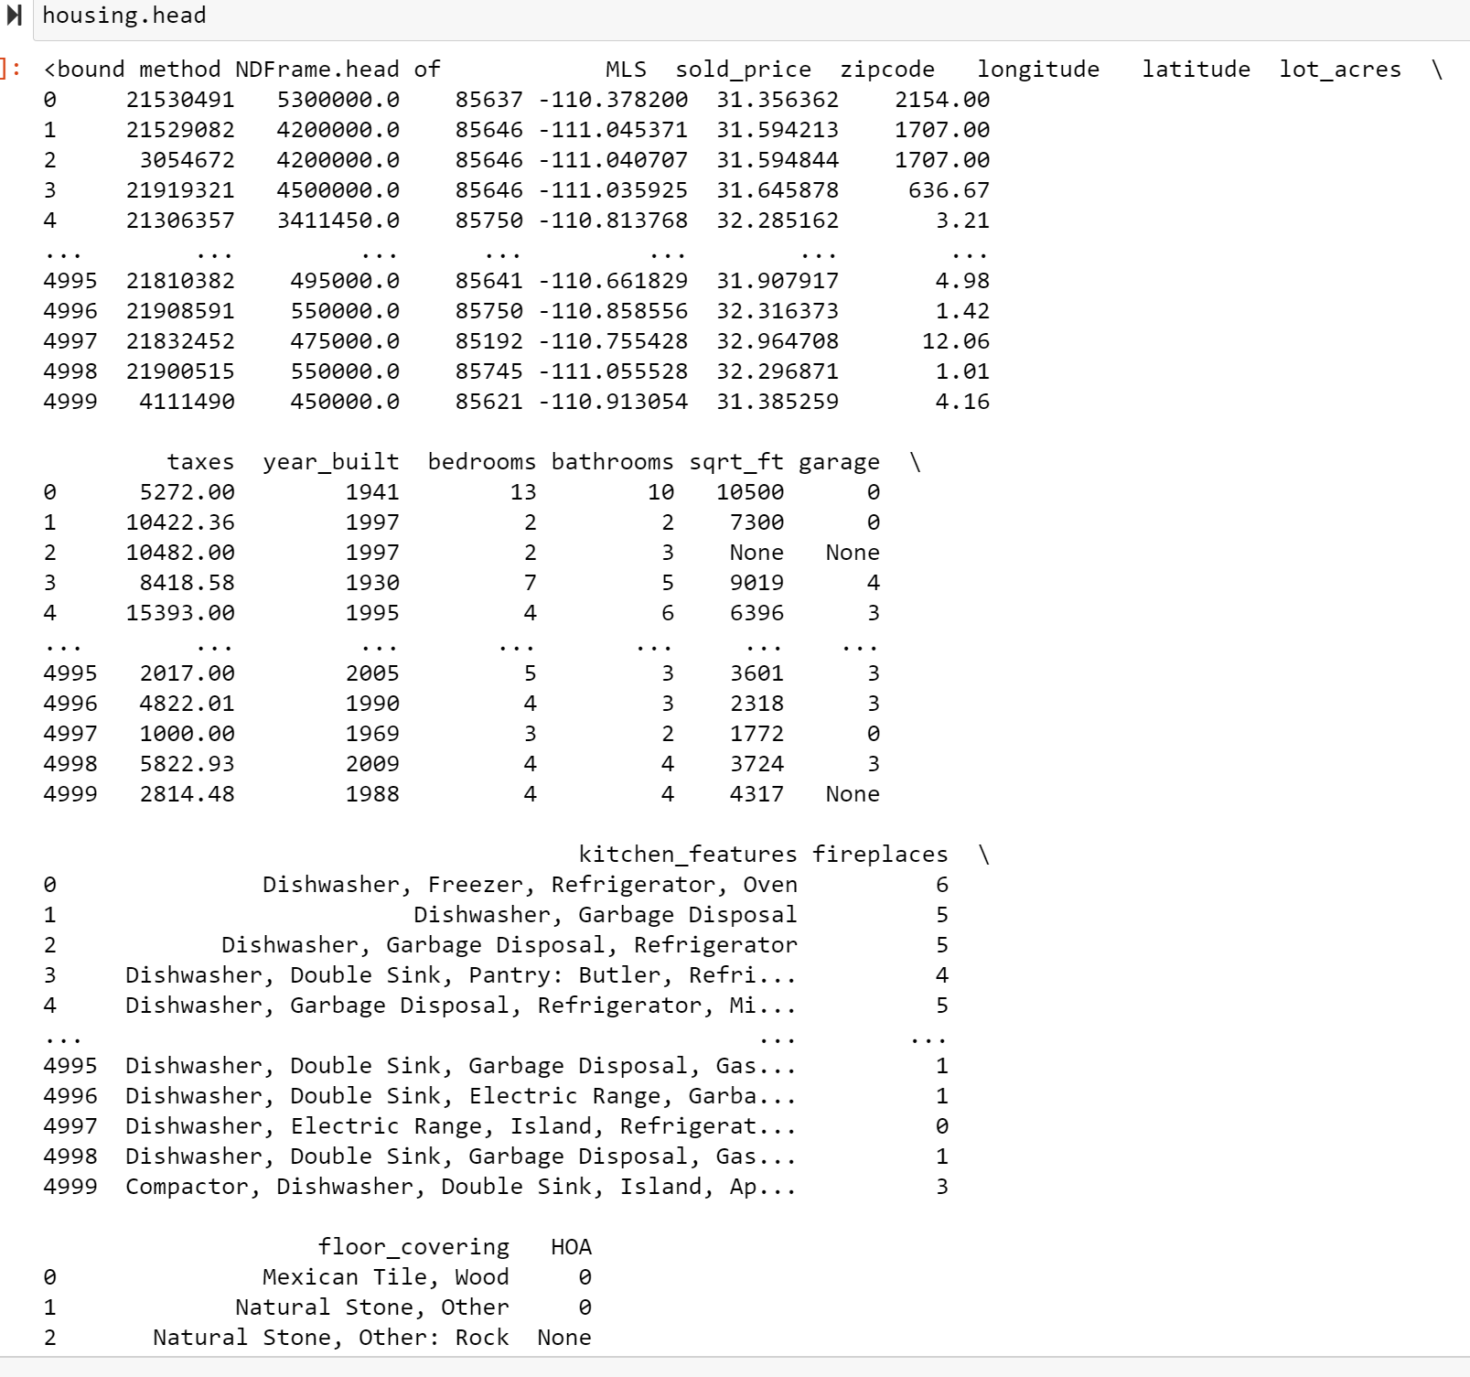
Exploratory Data Analysis (EDA)
First imported the raw housing data csv file into Python.
Then performed a head on the data set to view its attributes.

Slide 3
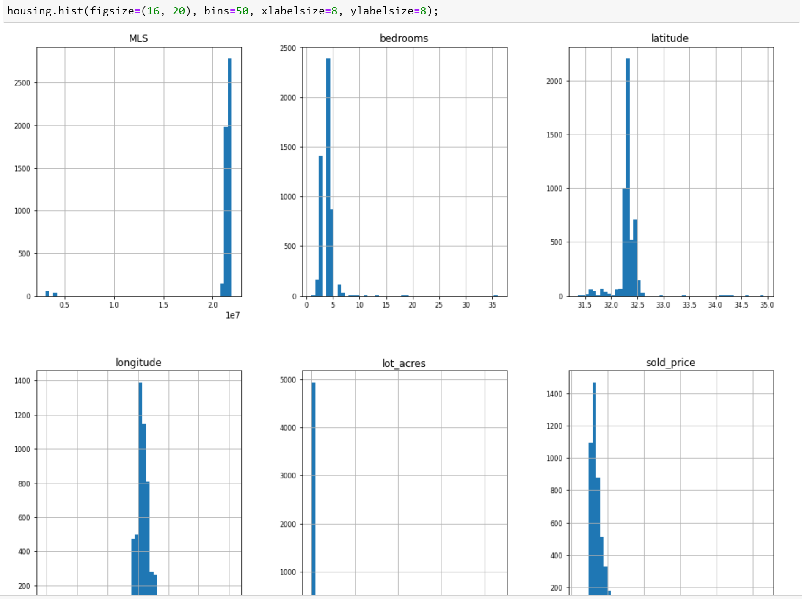
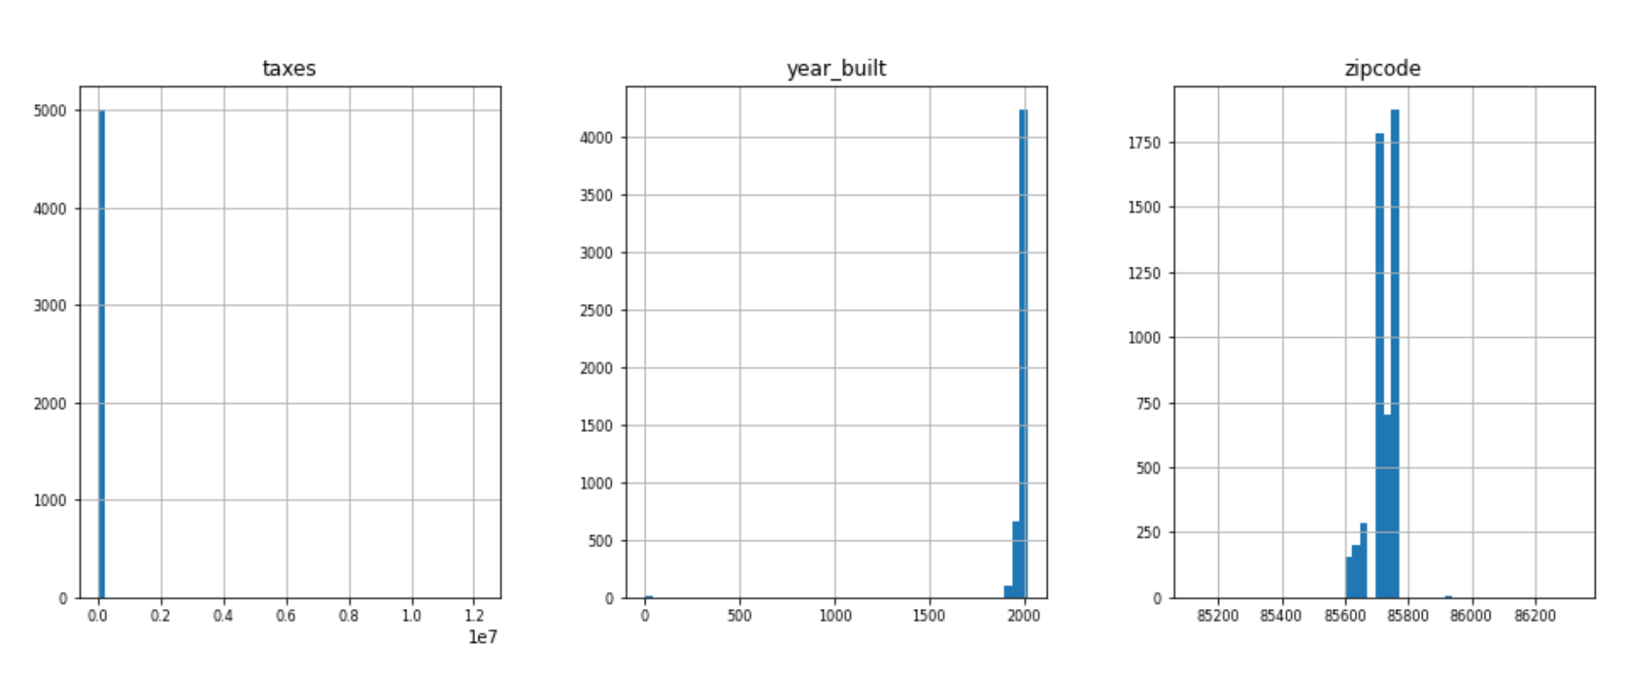
Histogram of Data Set
Performed a histogram on the data set.

Slide 4
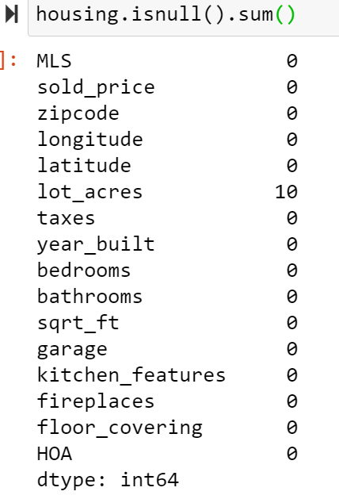
Columns with Missing Values The lot_acres has 10 missing values.

Slide 5
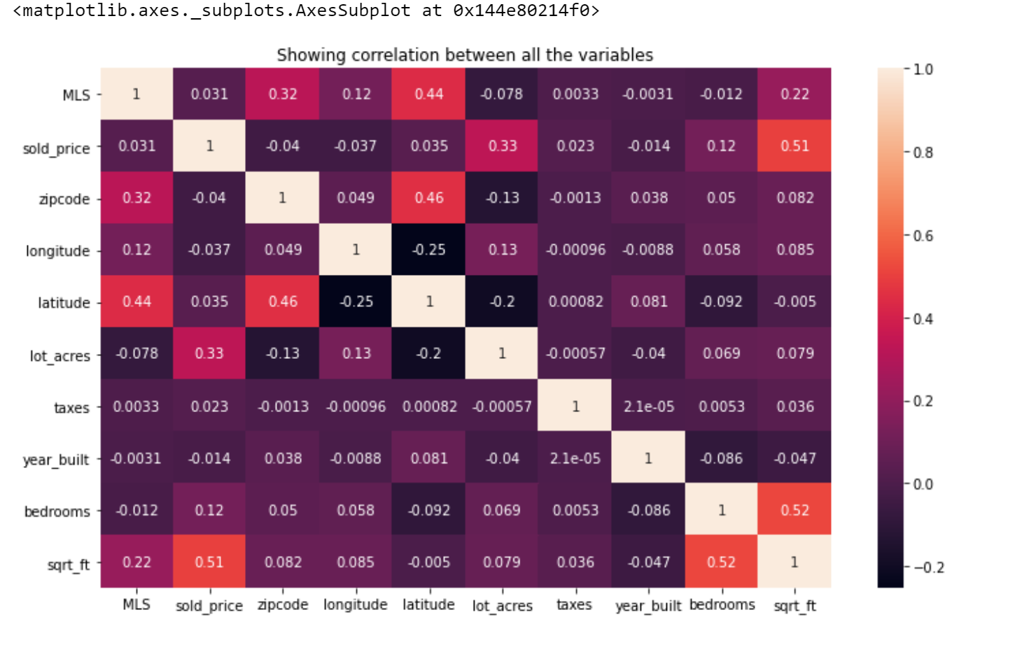
Heatmap of Missing Variables

Slide 6
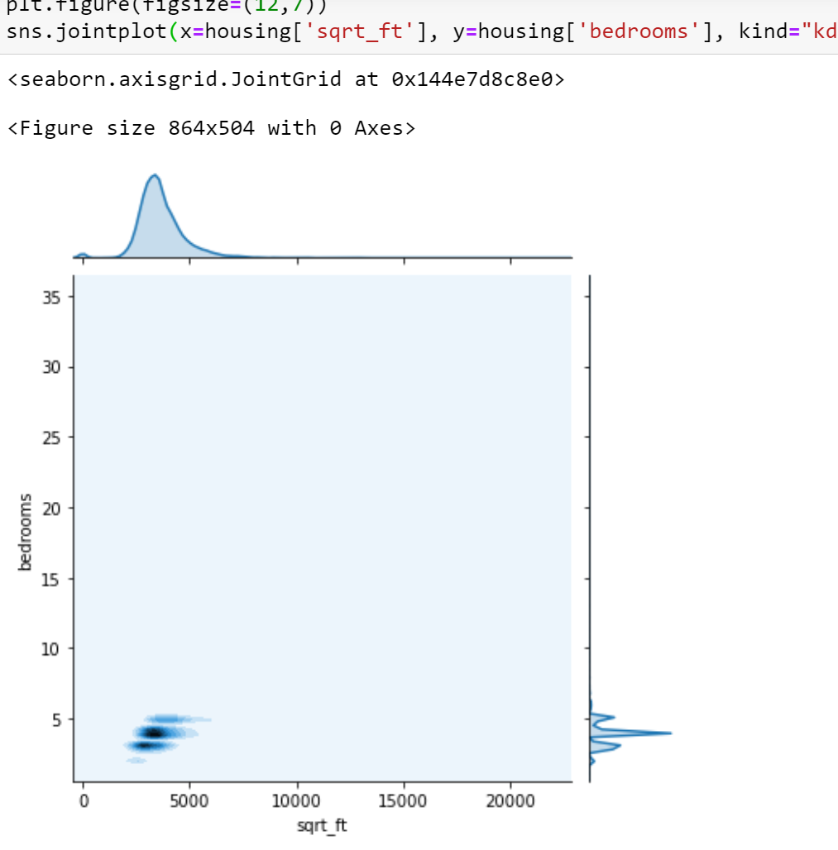
Distribution Plot Comparing Year built Correlation with Bedrooms

Slide 7
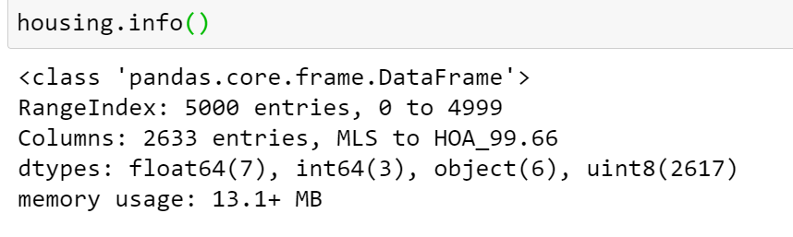
Dropping all Object Columns that have been One Hot Encoded

Slide 8
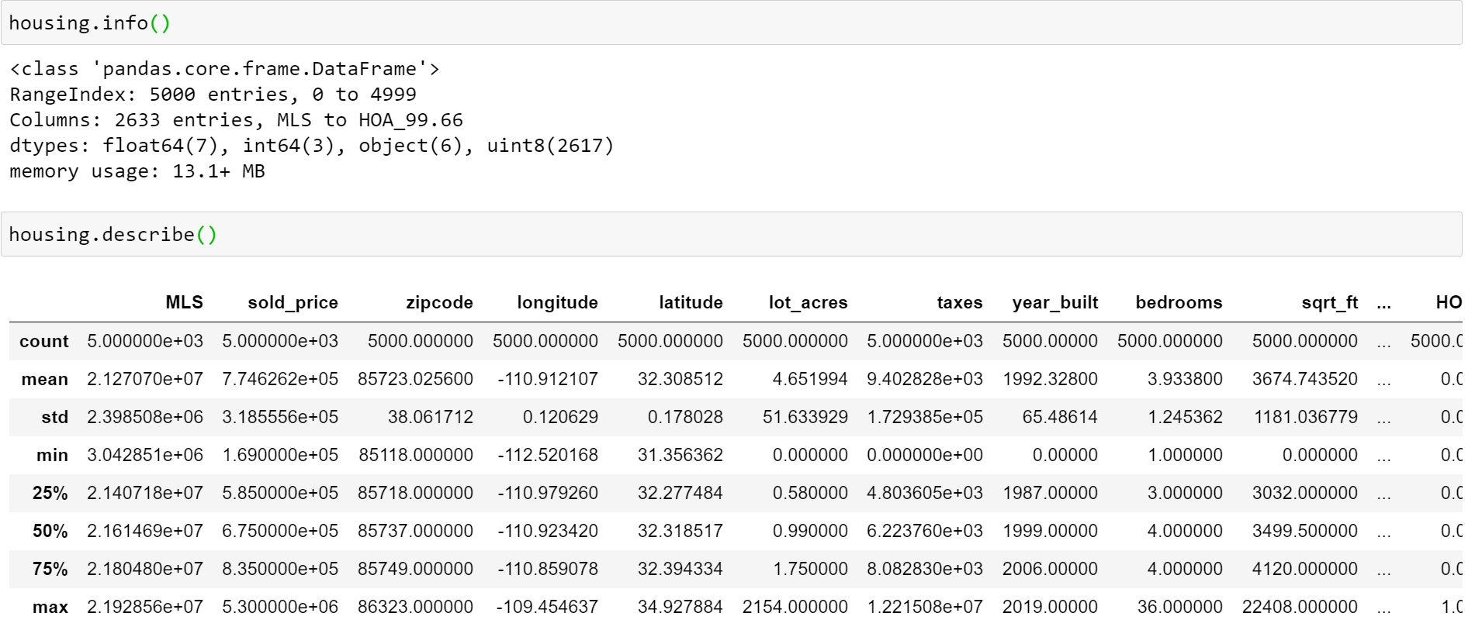
Trransformed Data Set Performed an info on it to view the structure of the file. The file has 5,000 entries. Performed an description of the file to see its columns. Which it has 16 columns or attributes.

